Slide 1
Multi-Lingual Machine Translation

Slide 2
The problem of Machine Translation can be solved using an Encoder and Decoder to build a Seq - Seq model with the help of LSTM’s.
Approach 1:
Training an embedding layer using the vocabulary of the training and validation data.
This approach did not produce results as expected, as any new word which could occur in the test set not present in the vocabulary cannot be translated. Hence, the approach did not produce good results.

Slide 3
Approach 2:
The previous problem could be solved by using pre trained embedded vectors of various languages (transfer learning) instead of training an embedding layer from scratch.
To determine the kind of language that was dominant in the dataset, I used fastText’s language identification API. Upon observing the results of all the 3 sets of data, French, Tagalog and Haitian seemed to dominate the dataset.
Using fast text’s word vectors, for French and Haitian, I built an embedding layer. But the model wasn’t performing good enough as 2/3rd of the embedded matrix had zero rows. This would mean that the model wouldn’t learn enough from the data.

Slide 4
Approach 3:
As it wasn’t feasible to download embedding for all the languages in the dataset, I chose only French and Haitian as they were dominant ones. Instead of taking into consideration all the data to train, I reduced the data set to only the sentences that were mapped to French, Tagalog and Haitian.
The advantage of doing this was that the embedded layer had very few zero rows.
The results for this approach weren’t the best as the data left for training after reducing dataset to only a specific languages was not sufficient.
Future Improvements:
More data for each of the languages would help in training the model better.

Slide 5
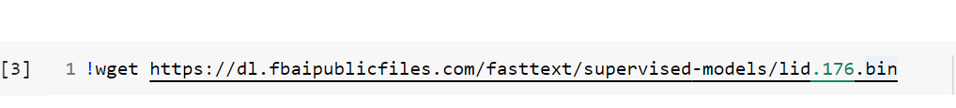
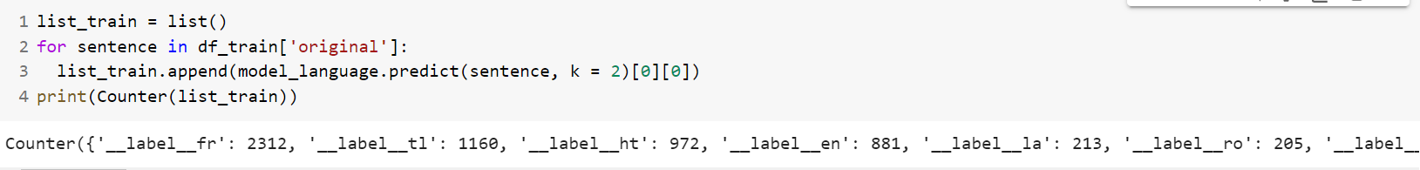
Code Walk
Language Identification
Count of sentences of various languages in the training set

Slide 6
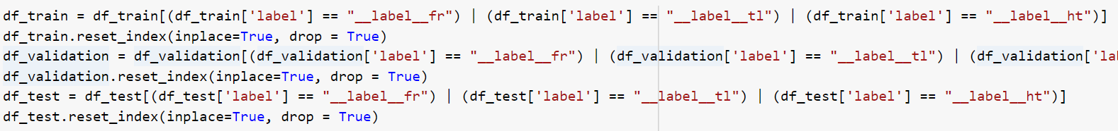
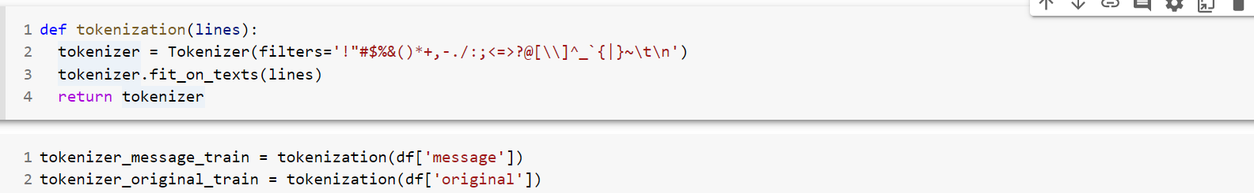
Reduced the data to only French, Tagalog and Haitian.
Tokenized the training and validation data
Token and index pair after tokenization

Slide 7
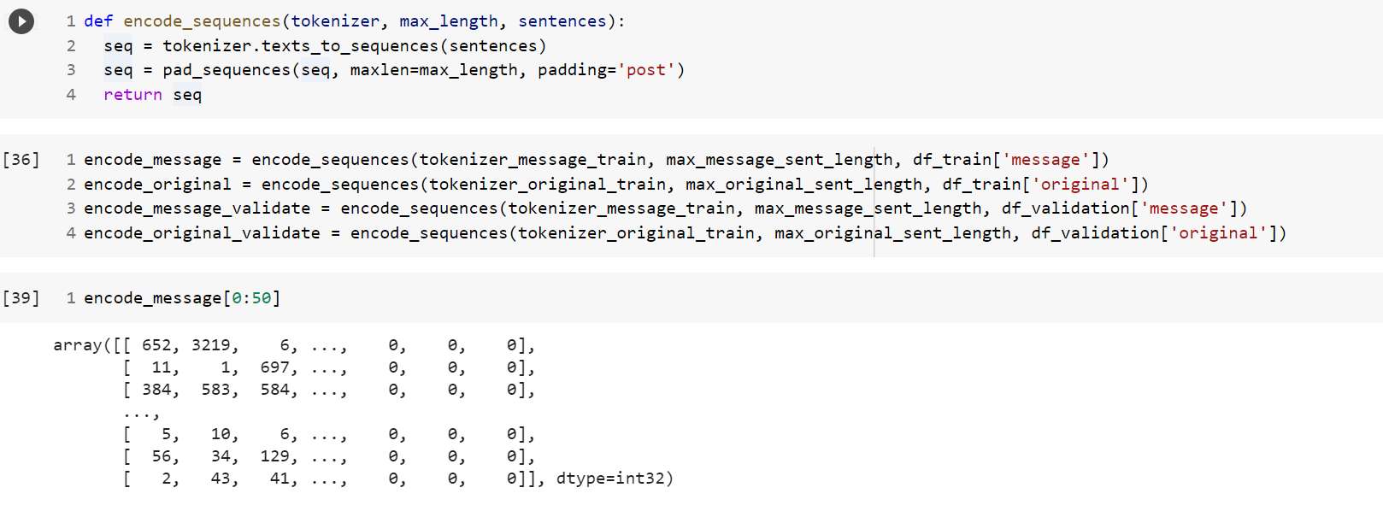
Each of the sentences in the training set encoded with a number after tokenizing the data

Slide 8
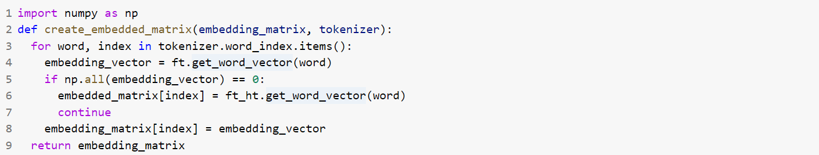
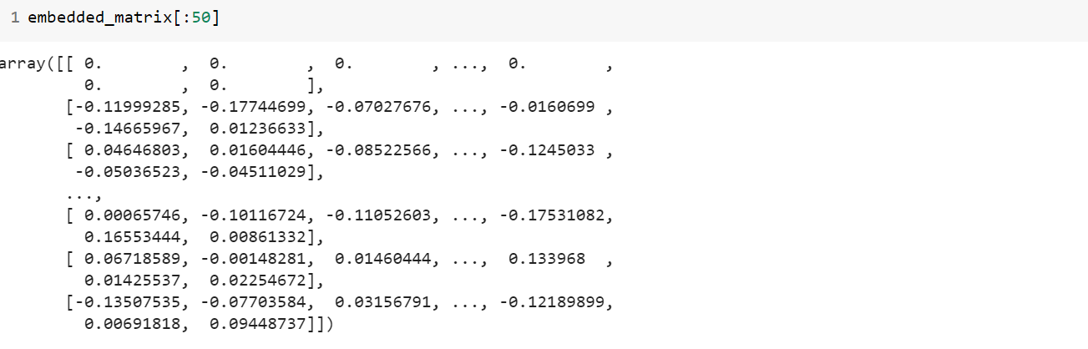
Embedded Matrix built using pre trained vectors from French and Haitian Language

Slide 9
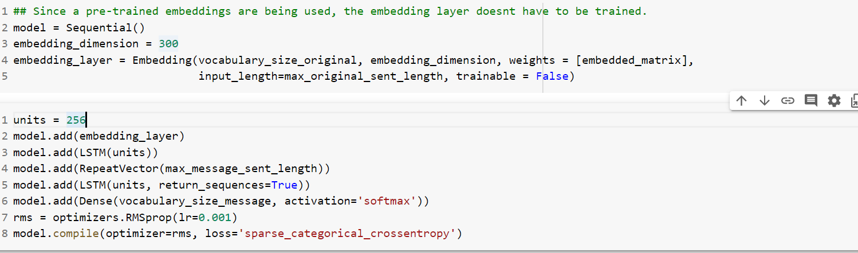
The first layer is the embedding layer followed by LSTM layer for encoding. The repeat layer is used to repeatedly generate the input, max output sentence length, times(max sentence length of English dataset).
The next layer is again the LSTM layer for decoding. The final layer is the dense layer which is placed at the output of the decoder with a SoftMax activation function.
The optimizer used to train the model is RMSprop as it is widely used for language translation.

Slide 10
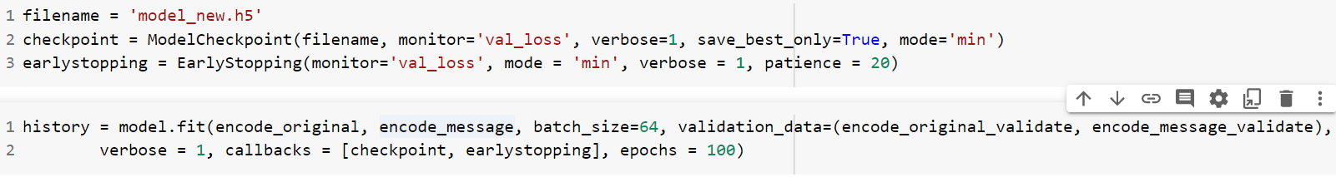
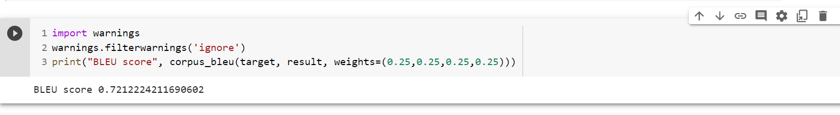
Early stopping and Model check point have been used to terminate the run as the validation loss stops improving.
The “patience” parameter has been set to 20 in order to run an extra 20 epochs after the improvement of the loss.
Evaluation metric used for Machine Translation problems is BLEU.

